Slide 1
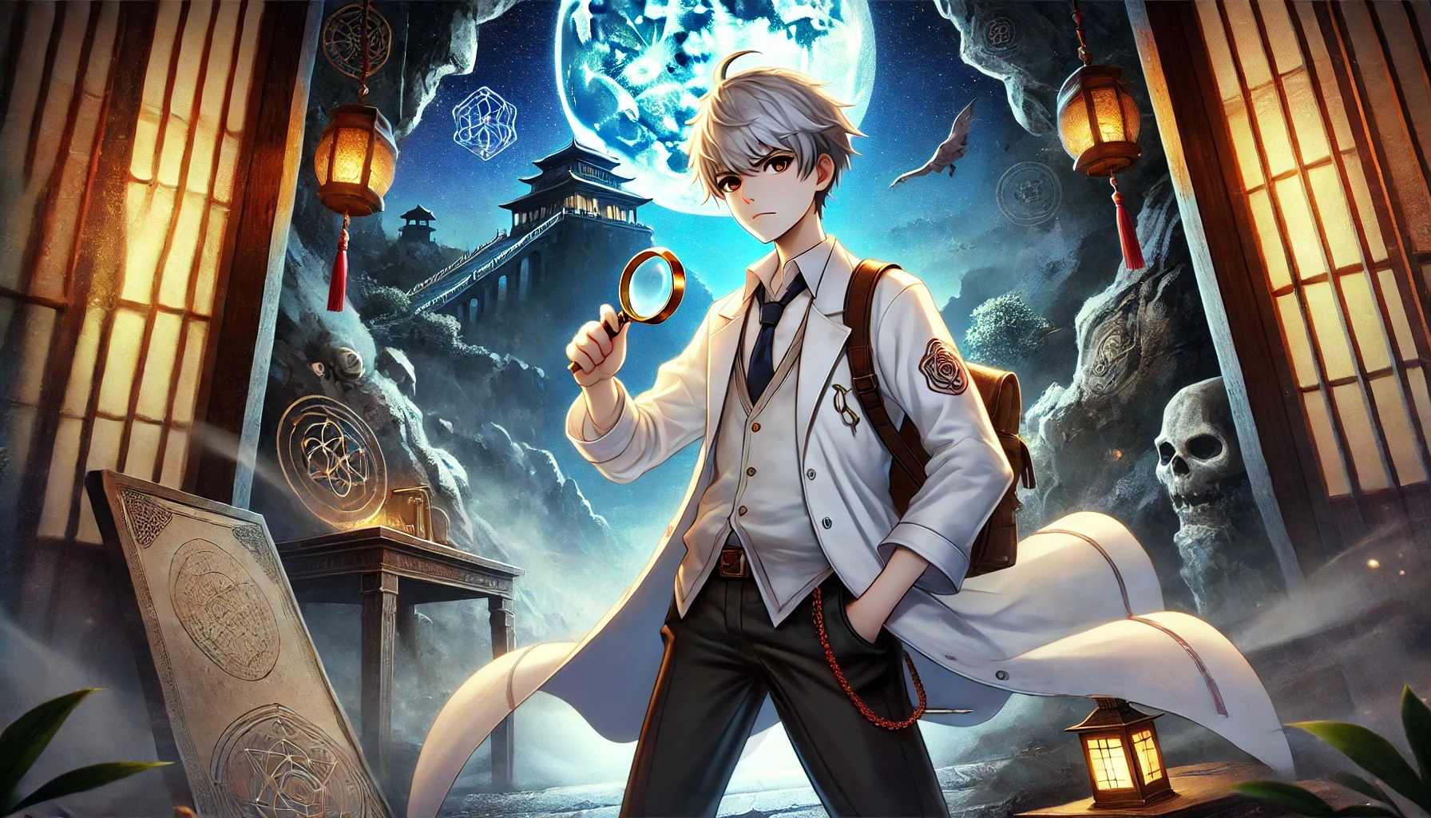
冒險故事篇
(VTube Studio)
Notes:
Prompt: An anime-style scene featuring a young male detective in a mysterious, moonlit environment. The character, with silver-gray hair, stands confidently in the center holding a magnifying glass, dressed in a white lab coat with a detective badge on his sleeve. His expression is serious and focused as he investigates. Behind him, a mystical, ancient temple stands on a foggy mountainside, illuminated by a bright, full moon casting an ethereal glow over the scene. The environment blends elements of ancient mystery and supernatural intrigue, with symbols etched into stone tablets, hanging lanterns casting a warm light, and a skull embedded in the rocky landscape. Flying creatures soar through the night sky, and glowing geometric shapes float in the air, adding to the eerie, otherworldly atmosphere. The scene combines a sense of adventure and investigation in a fantastical, supernatural setting.
哈囉~我是小白今天來聊聊冒險故事囉！

Slide 2
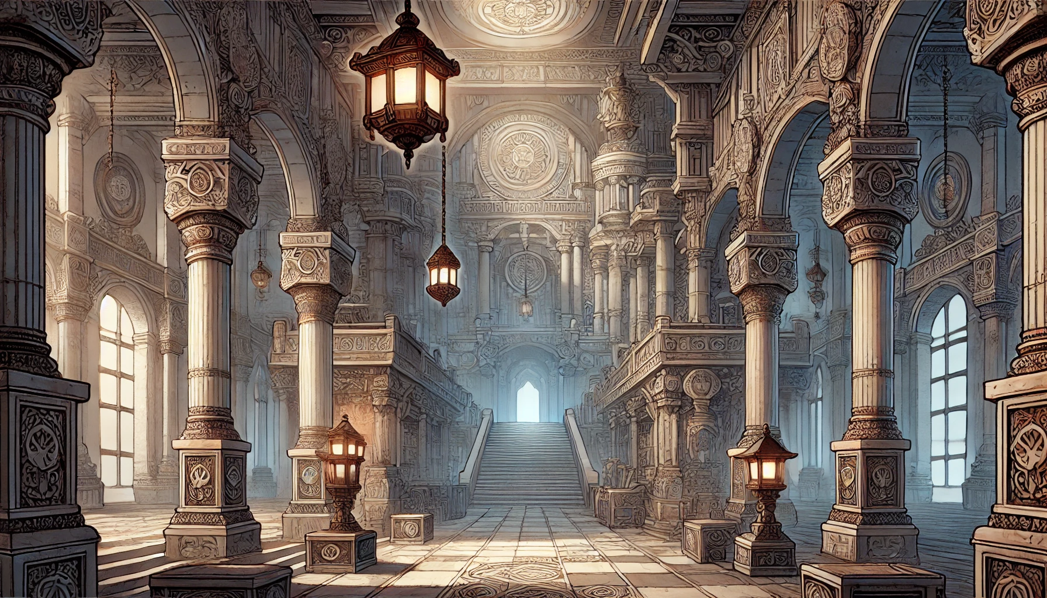
Notes:
Prompt: A grand, intricately designed ancient hall with towering stone columns and ornate carvings, evoking a sense of majesty and timelessness. The hall features large arched windows that allow soft light to filter in, casting long shadows across the floor. Elegant hanging lanterns illuminate the space with a warm, golden glow, while more lanterns rest atop stone pedestals. The architecture is richly detailed, with carved patterns and symbols adorning the pillars, walls, and ceilings. A grand staircase leads upward to a distant, glowing archway, suggesting a passage to another area of the majestic structure. The scene blends elements of ancient, classical architecture with a mystical, almost sacred atmosphere, as if this hall holds great historical or spiritual significance.
隨著我在法醫領域的進步，我的冒險才剛剛開始。

Slide 3
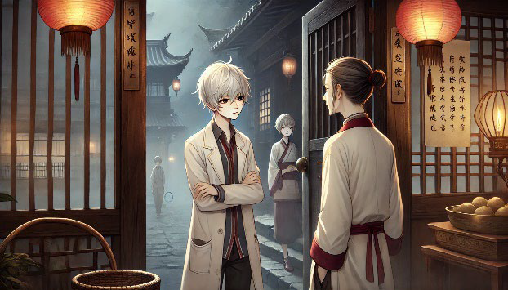
目標 Target
Notes:
Prompt: An anime-style scene set in a dark, eerie alley of an ancient village, lit dimly by hanging lanterns. The central character, a young male detective with silver hair, stands holding a flashlight in one hand and an old book in the other, as he looks ahead with a cautious, serious expression. He wears a trench coat and tie, fitting the role of a mystery investigator. The cobblestone street is wet, reflecting the lantern light, and the atmosphere is heavy with fog and shadows. In the background, a tall, ominous temple or pagoda looms under a cloudy, moonlit sky. A mysterious cloaked figure is seen in the distance, adding to the suspense and intrigue. The scene has a dark, gothic tone, filled with tension and the sense of uncovering hidden secrets in a supernatural or historical setting.
一天，我接到了一個神秘的案件，據說是一位年輕女子的失踪與一個古老的傳說有關。這引起了我的好奇心，於是我決定深入調查。

Slide 4
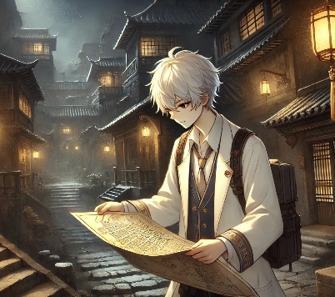
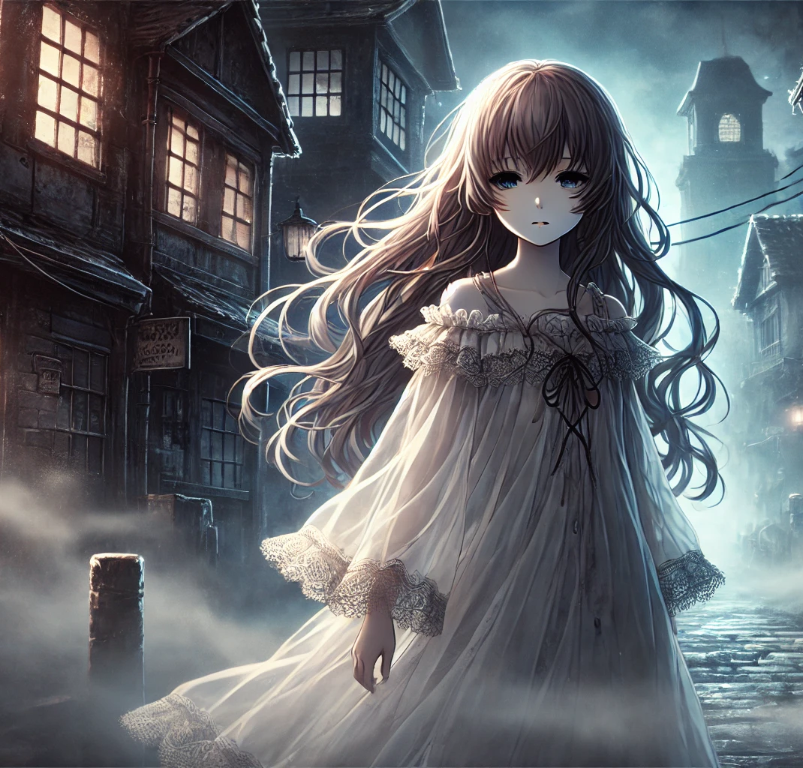
阻礙 Hinder
Notes:
Prompt (L): An anime-style scene set in a dimly lit, ancient village at night. The central character, a young male with silver hair, carefully studies an old map as he walks down a narrow, cobblestone street. He wears a white coat and a backpack, suggesting he's on a journey or investigation. The traditional wooden buildings around him are illuminated by warm lantern light, casting soft shadows and creating a mysterious atmosphere. The village has a quiet, eerie feel, with mist rolling in and the distant outline of rooftops blending into the dark, cloudy night sky. The character's focused expression adds to the sense of discovery and intrigue as he searches for clues in this quiet, historic setting.
Prompt (R): An anime-style scene set in a dark, foggy alley of an old, gothic town. A mysterious young girl with long, flowing hair stands in the center, her ethereal presence enhanced by the pale moonlight. She wears a flowing, lace-trimmed white dress that billows slightly in the mist, giving her a ghostly, haunting appearance. Her expression is calm and distant, with large, melancholic eyes, as if she carries a deep, untold story. The surrounding buildings are made of dark, weathered wood, with dim lanterns casting faint light onto the cobblestone street. The mist swirls around her feet, adding to the eerie, supernatural atmosphere. The scene evokes a sense of mystery and the supernatural, as though she is a spirit or a figure from a tragic past wandering the quiet, haunted streets.
在調查過程中，我發現失踪女子的家族與一個小鎮的歷史息息相關。

Slide 5
Notes:
這個小鎮據說曾經發生過一起懸而未解的謀殺案，與她的失踪案有著千絲萬縷的聯繫。

Slide 6
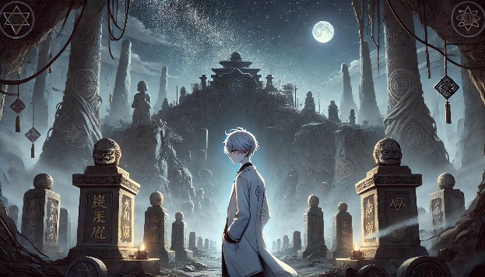
努力 Strive
Notes:
Prompt: An anime-style scene set in an old, traditional village at dusk, with soft lantern light illuminating the cobblestone streets. A young male with silver hair, wearing a white lab coat and red tie, stands in conversation with a woman dressed in traditional robes outside a tea house or inn. The two seem to be discussing something serious, with the young man standing calmly, arms crossed, while the woman faces him attentively. In the background, another figure dressed in a kimono can be seen walking out of the building, adding depth to the scene. The architecture features wooden sliding doors, hanging red lanterns, and calligraphy scrolls on the walls, evoking a historical and peaceful atmosphere. The soft fog rolling in and the warm light from the lanterns contribute to the quiet, serene, yet mysterious mood of the setting.
我拜訪了當地的老居民，他們對這個故事充滿了神秘感，甚至有人提到過一個被遺忘的地下洞穴。

Slide 7
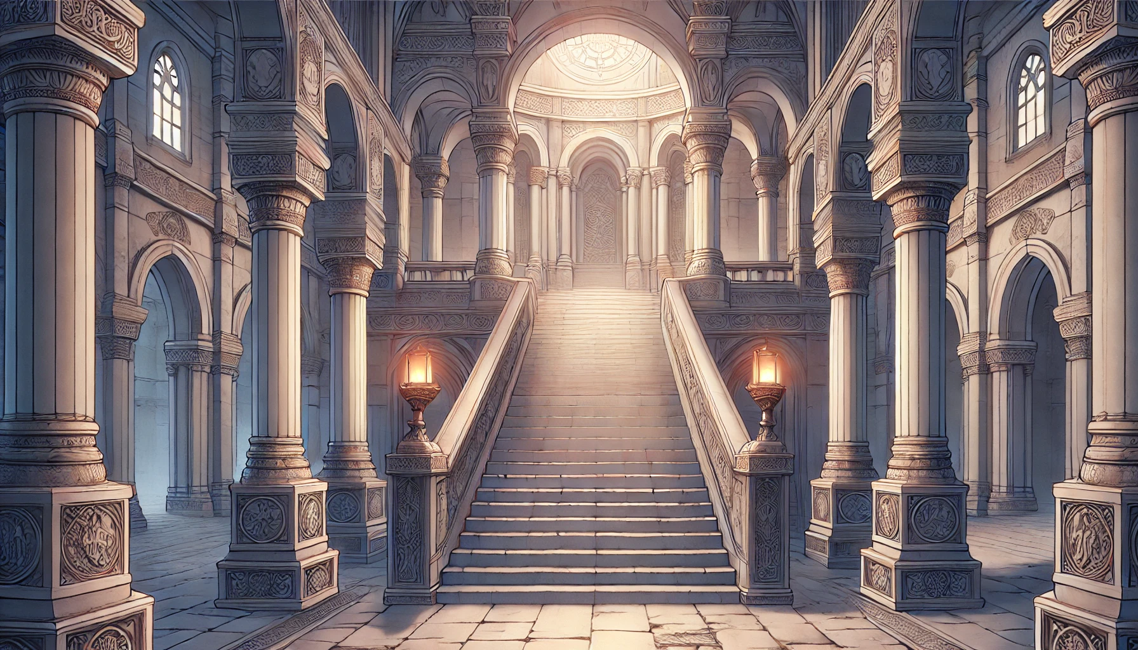
結果 Outcome
Notes:
Prompt: An anime-style scene set in a mysterious, ancient graveyard under a moonlit sky. The young male character, with silver hair and dressed in a long white coat, walks solemnly through rows of stone pillars and monuments engraved with ancient symbols. The setting is eerie and grand, with towering statues, ornate carvings, and mystical symbols adorning the pillars. Fog weaves through the gravestones, illuminated by the soft glow of small lanterns and candles. In the background, a large, imposing temple sits atop a rocky hill, its silhouette framed against a starry night sky and a full moon. The atmosphere is dark, mystical, and filled with a sense of ancient power and forgotten secrets, as if the character is uncovering a hidden truth or venturing into a sacred, forbidden place.
抱著探險的心情，我進入了那個洞穴。裡面暗黑潮濕，牆上佈滿了古老的符號。

Slide 8
意外 Accident
Notes:
Prompt: An anime-style scene set inside a dark, eerie cave illuminated by a shaft of light filtering from above. A young male character with silver hair, dressed in a long white coat with mysterious symbols on the back, stands at the center, gazing into the distance. The cave is filled with ominous details: skulls and bones scattered on the ground, occult symbols etched into the cave walls, and a hanging noose swaying above an altar near the water’s edge. The cave floor is inscribed with intricate, glowing patterns, giving the environment a supernatural and foreboding atmosphere. In the background, dark, still waters reflect the faint light, and a large mystical symbol is carved into the cave wall. The scene exudes a sense of ancient rituals, dark magic, and hidden secrets waiting to be uncovered.
隨著我的深入，我找到了一些被遺留的物品，這些都是當年謀殺案的關鍵證據。這時，我突然聽到了低語聲，像是有什麼東西在警告我。雖然有些害怕，但我知道我必須繼續。

Slide 9
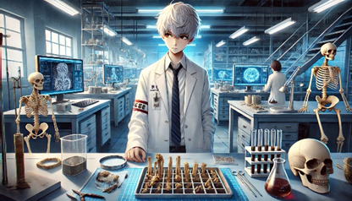
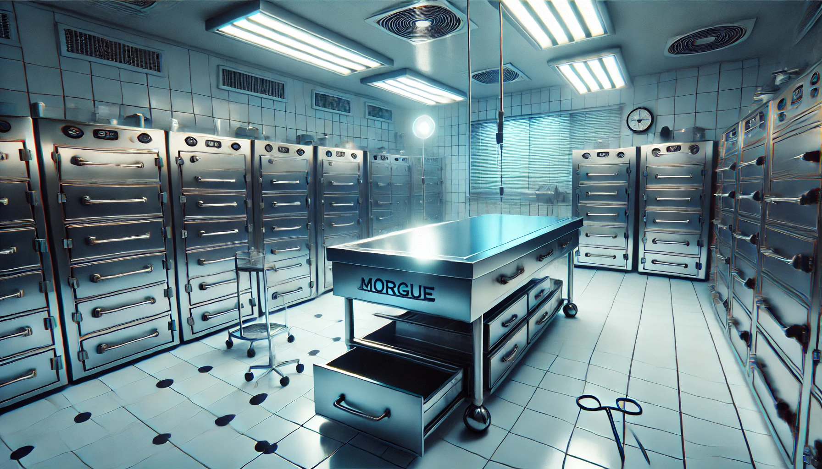
轉折
Turning Point
Notes:
Prompt (Top): An anime-style scene set in a high-tech forensic laboratory, where a young male scientist with silver hair analyzes bones on a table. Dressed in a white lab coat and tie, he stands focused on his work, surrounded by skeletal remains and various forensic tools, including test tubes and archaeological brushes. Computer screens in the background display 3D scans of bones and skulls, contributing to the cutting-edge forensic research environment. The laboratory is bright, with advanced equipment lining the room, and skeleton models standing nearby, adding to the sense of a detailed, scientific investigation. The atmosphere is professional, analytical, and calm, with a focus on solving a mystery through meticulous examination of human remains
Prompt (Down): A highly detailed, realistic scene of a sterile morgue, illuminated by bright fluorescent overhead lights. The room is clean and cold, with stainless steel autopsy tables at the center, one prominently labeled 'Morgue.' Surrounding the room are rows of refrigerated body storage units, each with identical handles and temperature gauges on the front. The tiled floor and walls, in shades of white and light gray, enhance the clinical, somber atmosphere. Medical tools, such as scissors and a small metal tray on wheels, are placed around the room, adding to the sense of recent or impending forensic work. A clock on the wall and a window with closed blinds contribute to the sterile, controlled environment, evoking a sense of professionalism, cold efficiency, and an underlying tension within this clinical setting.
最終，我將這些證據帶回實驗室，透過我的研究和分析，我成功揭開了失踪女子的真相。原來，她的失踪與當年謀殺案的真兇有關，而這個人竟然就是她的親戚。這個發現讓我震驚不已，但也讓我感到無比欣慰，因為我終於能夠幫助她的家人找到真相。

Slide 10
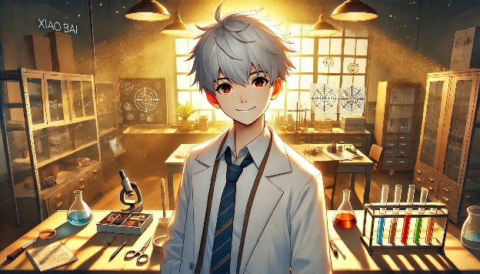
結局 Resolution
Notes:
Prompt: An anime-style scene set in a warm, sunlit laboratory. A young male scientist with silver hair stands in the center, smiling confidently. He wears a white lab coat over a shirt and tie, and is bathed in golden light streaming through large windows behind him, creating a serene and uplifting atmosphere. The laboratory is filled with scientific equipment, including test tubes with colorful liquids, a microscope, and various beakers on the table before him. Shelves and cabinets containing books and research materials line the room, and detailed diagrams can be seen on the walls. Dust particles float in the golden sunlight, adding to the peaceful and focused mood, while the glowing warm light suggests a sense of accomplishment or discovery.
這次冒險不僅讓我對法醫的工作有了更深的理解，也讓我明白，勇敢面對挑戰，才能讓我在追尋真相的道路上越走越遠。未來還有更多的案件等待著我去解開，我已經迫不及待了！

